Slide 1
Menus & Dialogs
Lecture 4
Tom Karni, Itsik Avidan

Slide 2
Menus - Intro
Common UI component in many types of applications

Slide 3
@Deprecated
Until Android 3.0 - Honeycomb ( API 11 ) , all Android devices had a menu button
Honeycomb removed the reliance on physical buttons, and introduced the ActionBar
The semantics to define a set of actions and options is still based on the Menu APIs.

Slide 4
Menu XML
Standard XML format to define menu items
*.XML file should be created under <project>/res/menu/
Allows better handling
Should contain the following :
<menu> - menu container, must be the root
<item> - single menu item, may contain nested <menu>
<group> - allows to categorize <item> so they share properties

Slide 5
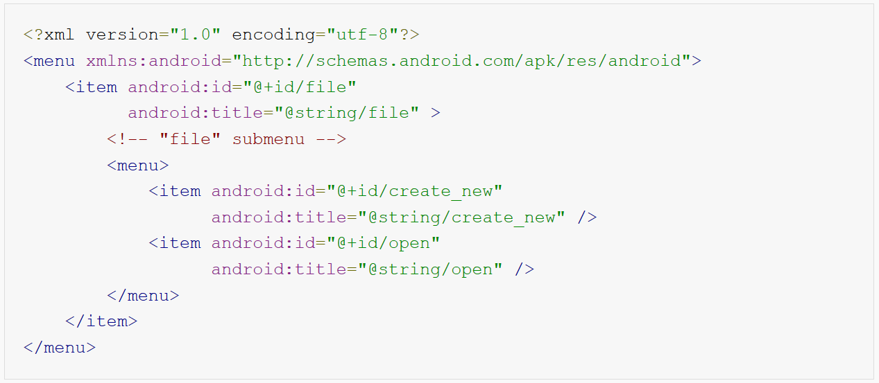
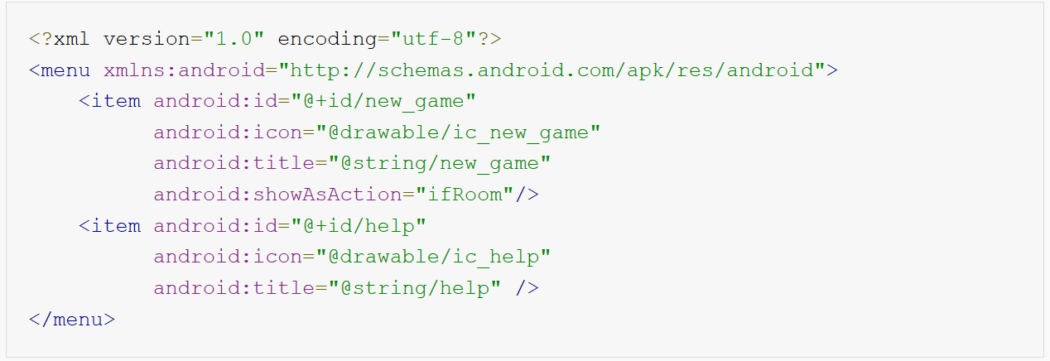
Menu XML

Slide 6
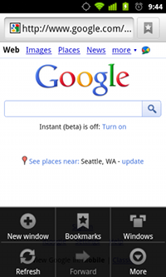
Option Menu
The option menu is the primary collection of menu items
Should contain actions with a global impact on the App (Settings, Search, New …)
@Deprecated :
=< Android 2.3 - menu button on device panel
>= Android 3.0 – items from the menu are presented in the Action bar

Slide 7
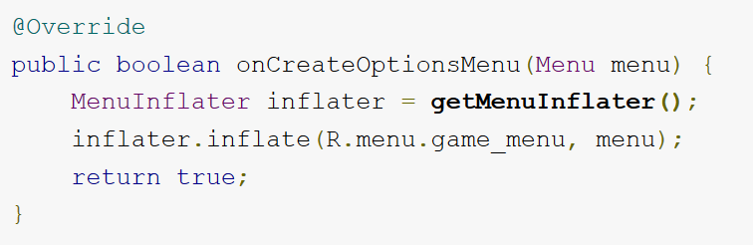
Option menu - create
Up to 6 items
To handle the menu event, override the onCreateOptionMenu()
Can add items from within the Activity using add()
After creation – onPrepareOptionsMenu()

Slide 8
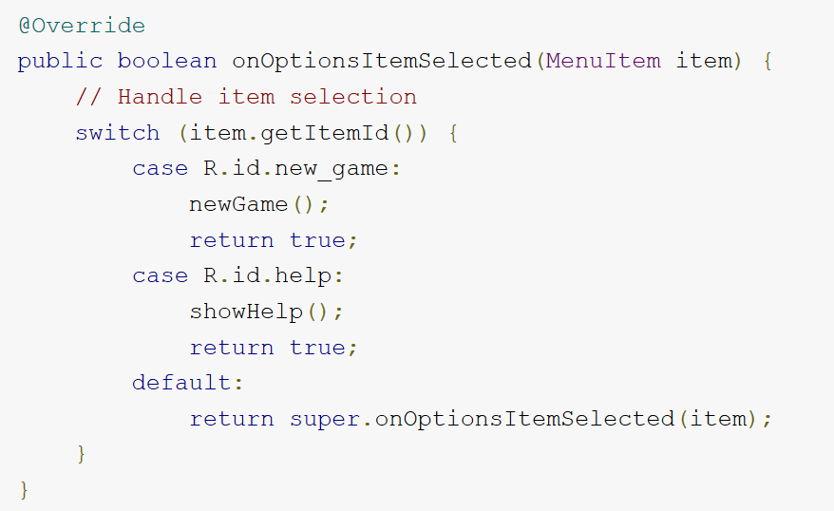
Click Events

Slide 9
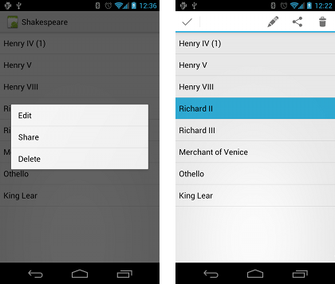
Context Menu
Flouting menu that appears upon longClick on an element
Provides actions relevant to the selected element
Most often used for ListView, GridView…
@deprecated – from API 11, use contextual action mode

Slide 10
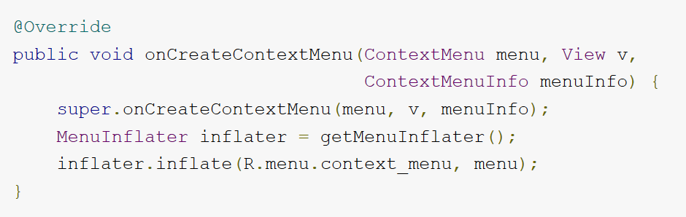
Context Menu - create
Register the wanted view with registerForContextMenu(View)
Implement onCreateContextMenu()
Implement onContextItemSelected()

Slide 11
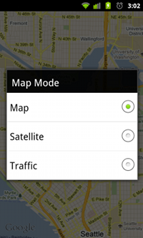
Pop-Up Menu
Displays a list of items in a vertical list
Good for providing an overflow of actions that relate to specific content or as a “second level” for the option menu
Should not directly affect the corresponding content—that's what contextual actions are for.

Slide 12
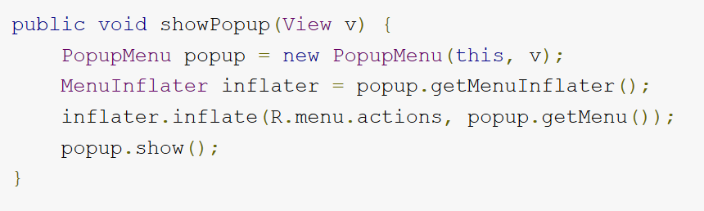
Pop-Up Menu - create
The creation can be called as a operation in an other menu or in the Activity
Create the menu using the PopupMenu() constructor
Implement onMenuItemClick()

Slide 13
Dialogs
Small window that appears in the foreground of the current Activity
Used for notifications that should interrupt the user and to preform short tasks
Should use one of the Dialog.class subclass – AlertDialog, ProgressDialog, DatePickerDialog, TimePickerDialog …

Slide 14
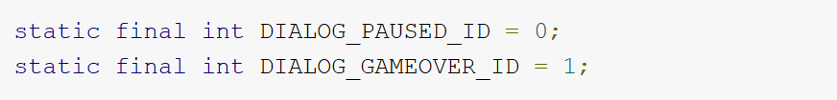
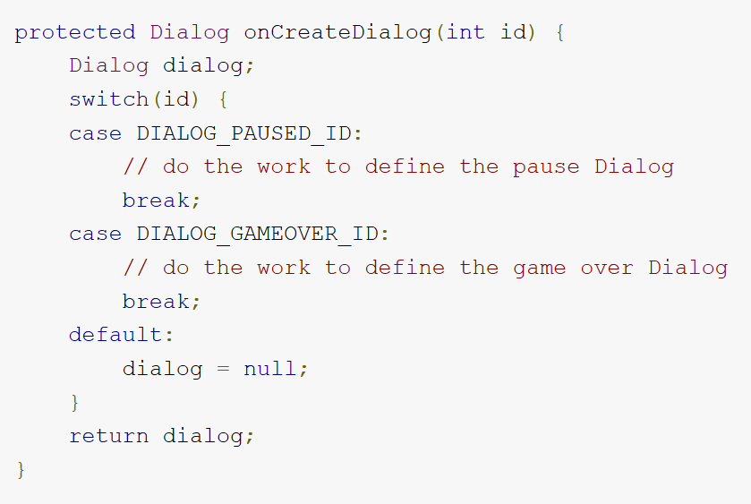

Dialog – create
Implement onCreateDialog(int)
Optional - Implement onPrepareDialog(int, Dialog)
Call showDialog(dialogId)
Dialog can be closed using dismiss()

Slide 15
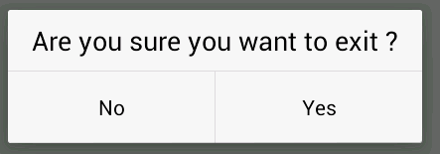
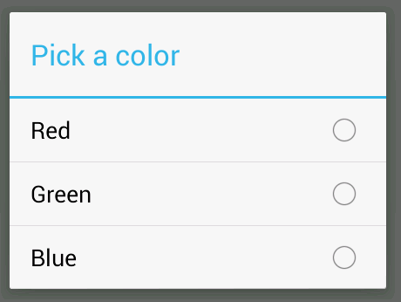
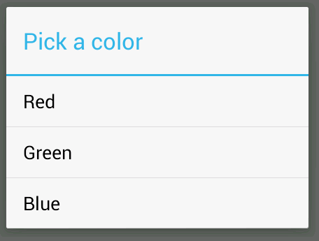
Alert Dialog
Contains :
Title
Text message
1 – 3 buttons
List of selectable items
Extends Dialog.class

Slide 16
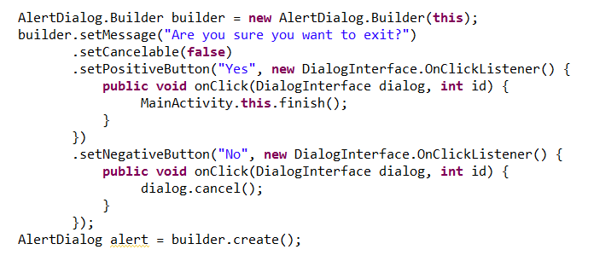
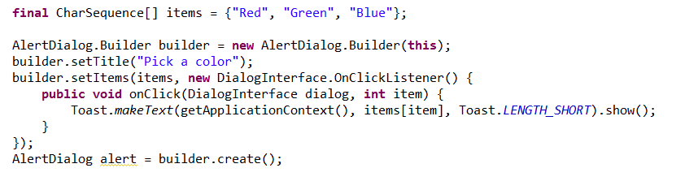
Alert Dialog

Slide 17
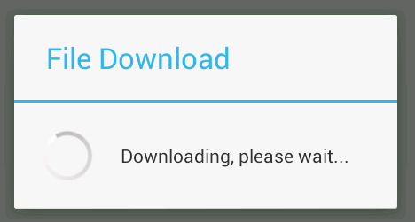
Progress Dialog
Extension of the AlertDialog, display a progress animation
The default style is the spinning wheel, for a task with undefined progress
Can be show with animated progress bar
Can increment the amount of progress displayed by calling setProgress(int) or incrementProgressBy(int)

Slide 18
Custom Dialog
Can create customize design for the dialog
Creating a view using *.XML file or code
Set the layout as the dialog’s content view
Show the dialog

Slide 19
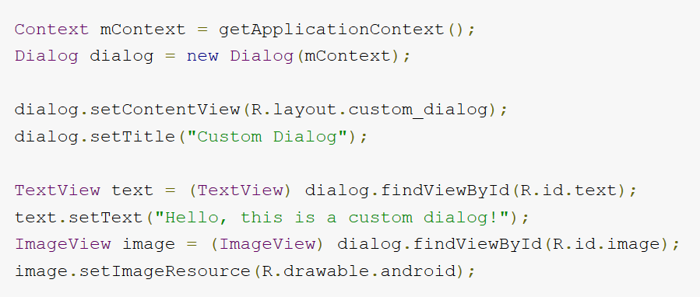
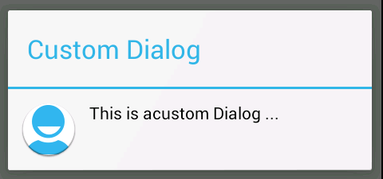
Custom Dialog

Slide 20
Notifications
Notify the user about an event that occurs in your application
If the application is running in the background and needs the user's attention

Slide 21
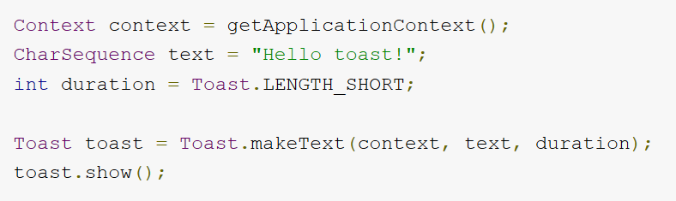
Toast Notification
Pops up on the surface of the window
The current Activity remains visible and intractable
Automatically fades in and out
Can be modified
Length
Position
Custom layout

Slide 22
Status Notification
Adds an icon to the system’s status bar and a notification message
When the user selects the notification, an Intent fires and lunch an Activity
Can be configures to alert sound, vibration etc.

Slide 23
Status notification
Should be used when a background Service need to create an alert
A background Service should never launch an Activity on its own
The user should decide what his current context

Slide 24
References
Android developers [http://www.android.com/develop] [http://developer.android.com/guide/components/index.html]
W.Frank Ableson, Robi Sen, Chris King. “Android in Action, 2nd edition”, 2011.

